Slide 1
Agent Architectures

Slide 2
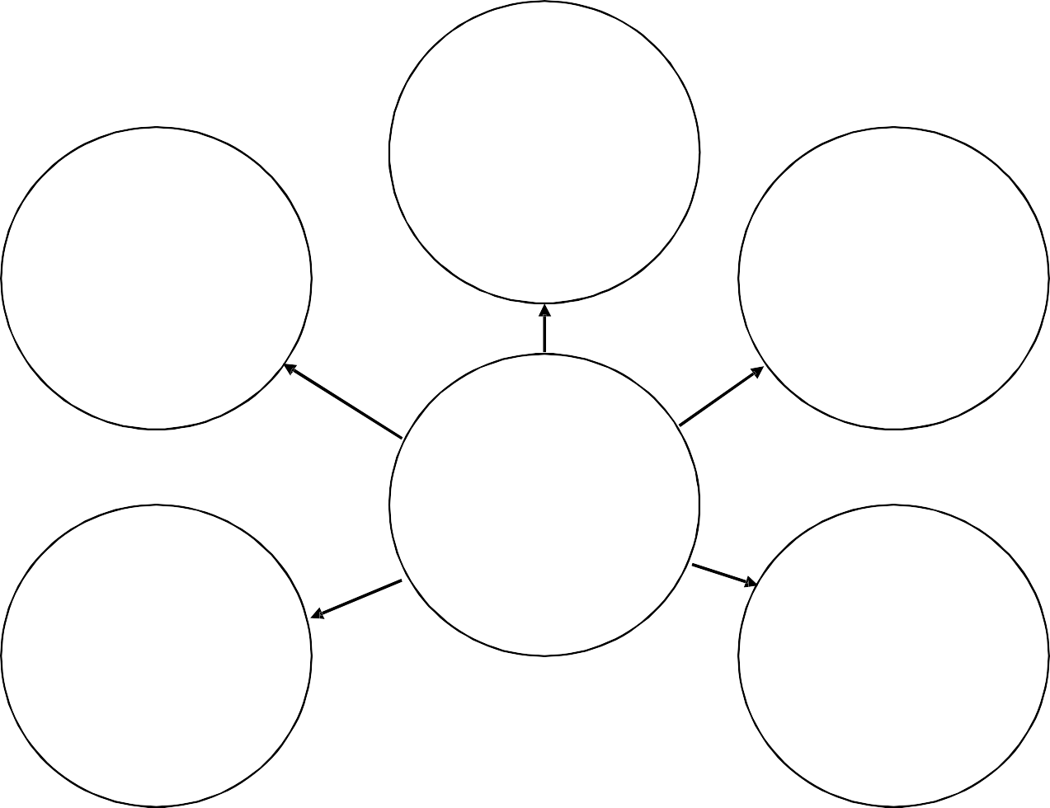
Agent architectures
Deliberative Agents
Reactive Agents
Hybrid Agents
Agent Architectures
Interacting Agents
Other Approaches

Slide 3
Agent Architectures
Reactive Agent
Each behaviour continually maps perceptual input to action output
Reactive behaviour:
action: S -> A
where S denotes the states of the environment, and A the primitive actions the agent is capable of perform.
Example:
Heater on, if temperature too low
action(s) =
Heater off, otherwise

Slide 4
Agent Architectures
Reactive Agent
Agent
S
e n s o r s
Stimulus-response behaviours
E
f
f
e
c
t
o
r
s
State₁ Action₁
State₂ Action₂
. .
State_{n} Action_{n}
E
f f e c t o r s
S
e n s o r s
State₁
Action₁
State₂
Action₂
State_{n}
Action_{n}

Slide 5
Agent Architectures
Reactive Agent
Problems
a great deal of local information needed
learning?
Typically “handcrafted”
Development takes a lot of time
Impossible to build large systems?
Can be used only for its original purpose
Examples
Vacuum world

Slide 6
Agent Architectures
Deliberative Agent
Explicit symbolic model of the world in which decisions are made via logical reasoning, based on pattern matching and symbolic manipulation
sense-plan-act problem-solving paradigm of classical AI planning systems

Slide 7
Agent Architectures
Deliberative Agent
Agent
E
f f e c t o r s
S
e n s
E
f f e c t o r s
S
e n s o r s
World Model
Planner
Plan executor
World
Model
Planner
Plan
executor
o
r s

Slide 8
Agent Architectures
Deliberative Agent
Examples of deliberative architectures
BDI ( Belief, Desire and Intention)
Shoham: Agent-Oriented Programming (a logical system for defining the mental state of agents)

Slide 9
Agent Architectures
Deliberative Agent
Performance problems
transduction problem
time consuming to translate all of the needed information into the symbolic representation, especially if the environment is changing rapidly.
representation problem
how the world-model is represented in symbolically and how to get agents to reason with the information in time for the results to be useful.
Late results may be useless
Does not scale to real-world scenarios

Slide 10
Hybrid architectures
Combine reactive and deliberative components and form a hierarchy of interacting layers
Each layer reasons at a different level of abstraction
Two types of layering:
Horizontal layering
Vertical layering

Slide 11


Agent Architectures
Hybrid Agent
Agent
S
e n s o r s
Deliberative component
E
f f e c t o r s
World Model
Plan executor
World
Model
Planner
Plan
executor
Planner
S
e n s o r s
E
f f e c t o r s
observations
modifications
Reactive component
State₁
Sta.te₂
.
State_{n}
Action₁
Action₂
.
.
Action_{n}

Slide 12
Agent Architectures
Hybrid Agent
Combination of deliberative and reactive behaviour
An agent consists of several subsystems
Subsystems that develop plans and make decisions using symbolic reasoning (deliberative component)
Reactive subsystems that are able to react quickly to events without complex reasoning (reactive component)
Layered architectures

Slide 13
Agent Architectures
Hybrid Agent
Action output
Layer_{n}
Layer_{n-1}
Layer_{n}
.
Layer₂
Layer_{n-1}
Sensor input
.
Layer₂
Action output
Layer₁
Layer₁
Sensor input
Action output

Slide 14
Reactive Agents
Controller
World
Stimuli Pattern 1
Plans Plan 1
E
f f e c t
S
e n s
Pattern 2
Plan 2
.
.
.
.
Pattern n
.
.
Plan n
o
r
o
r
Agent

Slide 15
Deliberative Agents
Cognition
Inference Strategies
Goals
World
Memory
E
f f e c t
S
e n s
Environment Model
Utility Function
Inter- pretation
o
r
Domain Knowledge
o
Planner
r
Agent

Slide 16
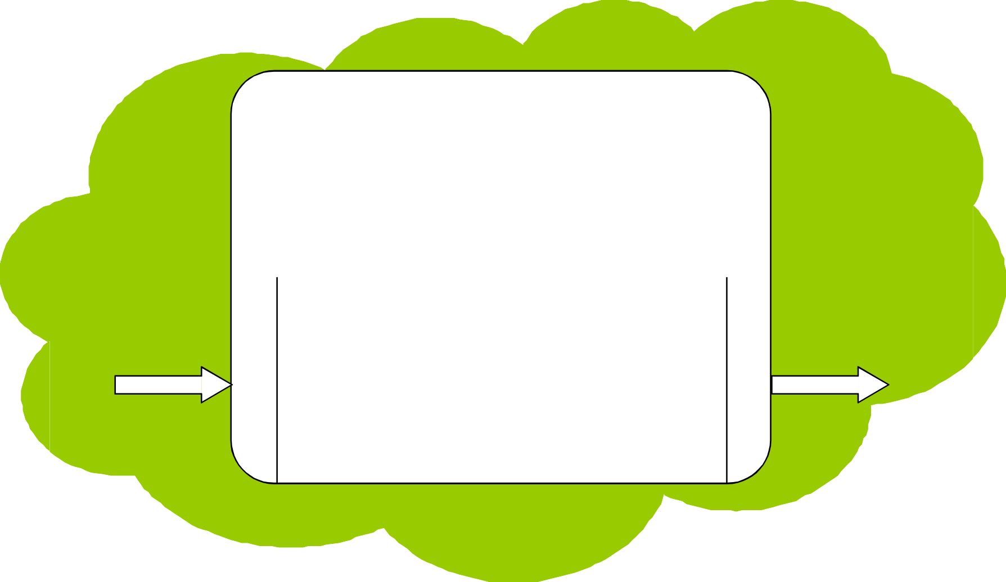
Hybrid Agents
Cognition
Inference Strategies
Memory
World
Goals Utility
Function
Inter- pretation
Planner
Environmen t Model
Domain Knowledge
S
e n s
Stimuli
Agent
E
f f e c t
Pattern 1
Plans
Pattern 2
Plan 1
o
r
.
.
Pattern n
Plan n
o
r

Slide 17
Example: TouringMachines
Modeling layer
Sensory input
Action output
Planning layer
Reactive layer
Control rules

Slide 18
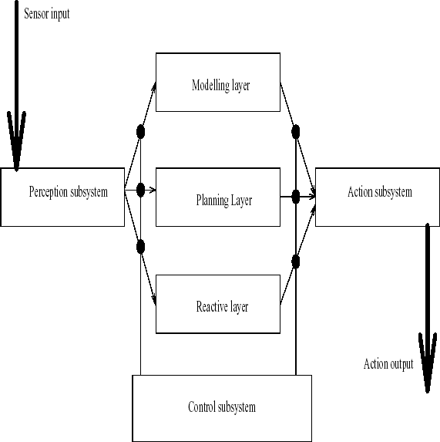
Ferguson –
TOURINGMACHINES

Slide 19
Ferguson – TOURINGMACHINES
The reactive layer is implemented as a set of situation- action rules, a la subsumption architecture
Example:
rule-1: kerb-avoidance if
is-in-front(Kerb, Observer) and speed(Observer) > 0 and separation(Kerb, Observer) <
KerbThreshHold then
change- orientation(KerbAvoidanceAngle)
The planning layer constructs plans and selects actions
to execute in order to ac^{Int}h^{ell}i^{ig}e^{en}v^{t A}e^{g n}t^{ts}he agent’s goals
25 of 38

Slide 20
Ferguson –
TOURINGMACHINES
The modeling layer contains symbolic
representations of the ‘cognitive state’ of other entities in the agent’s environment
The three layers communicate with each other and are embedded in a control framework, which use control rules
Example:
censor-rule-1: if
entity(obstacle-6) in perception-buffer
then
remove-sensory-record(layer-R, entity(obstacle-
6))
26 of 38

Slide 21
Reactive layer
Acts as a reactive agent and responds to changes as they occur
Implemented through situation-action rules
There is no model of the environment in this layer
Planning layer
Achieves the agent’s pro-active behaviour via plans based on a library of plan skeletons or schemas
27 of 38

Slide 22
Modelling layer
Endows the agent with reflective and predictive capabilities
Entities are modelled as having a configuration, beliefs, desires and intentions
Generates goals to resolve conflicts which are then propagated to the planning layer
Control subsystem
Decides which of the layers has control over the agent
It is implemented via control rules which can either suppress sensor information between the control rules and the control layers or else
censor action outp_{CS}u₈₆₉t₁s_{-AI-U}f_{N}r_{IT}o_{4-A}m_{rchite}t_{ct}h_{ure}e_{for} control lay₂e_{8 o}r_{f}s₃₈

Slide 23
Vertical layering
Action output
Layer n
Layer n
Layer 2
Layer 2
Layer 1
Layer 1
Sensory input
Action output
Sensory input
One-pass
Two-pass
29 of 38

Slide 24
Advantages
Low complexity. If there are n layers there are n-1 interfaces between them. If each layer is capable of suggesting m possible actions then there are at most m²(n-1) interactions
No central control, no bottleneck in the agent’s decision making
Problems
Less flexible
Not fault tolerant

Slide 25
Agent Architectures
Hybrid Agent
Agent
S
e n s o r s
Deliberative component
E
f f e c t o r s
World Model
Plan executor
World
Model
Planner
Plan
executor
Planner
S
e n s o r s
E
f f e c t o r s
observations
modifications
Reactive component
State₁
Sta.te₂
.
State_{n}
Action₁
Action₂
.
.
Action_{n}

Slide 26
Agent Architectures
Hybrid Agent
Action output
Layer_{n}
Layer_{n-1}
Layer_{n}
.
Layer₂
Layer_{n-1}
Sensor input
.
Layer₂
Action output
Layer₁
Layer₁
Sensor input
Action output

Slide 27
Agent Architectures
Hybrid Agent
example - InteRRaP
Cooperation layer
Social knowledge
Plan layer
Planning knowledge
Behaviour layer
World model
World interface
Perceptual input
action output

